Slide 1
Predicate Resolution Exercise 4.1
Badea Dan-Nicolai

Slide 2
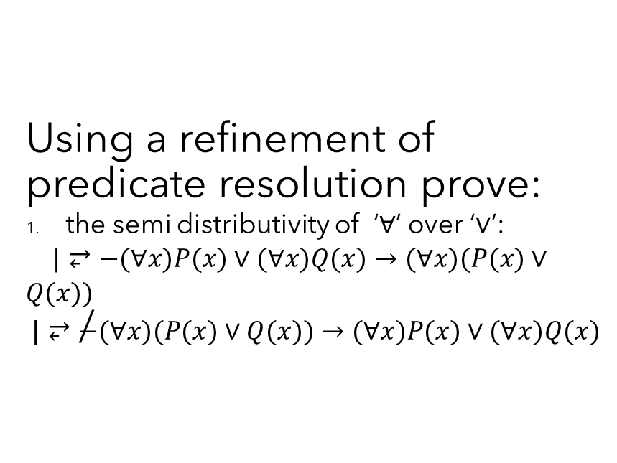
Exercise statement
Using a refinement of predicate resolution prove:
the semi distributivity of ‘$∀$’ over ‘$∨$’:
$|⥂−(∀x)P(x)∨(∀x)Q(x)→(∀x)(P(x)∨Q(x))$
$$|⥂\overset{̸}{−}(∀x)(P(x)∨Q(x))→(∀x)P(x)∨(∀x)Q(x)$$

Slide 3
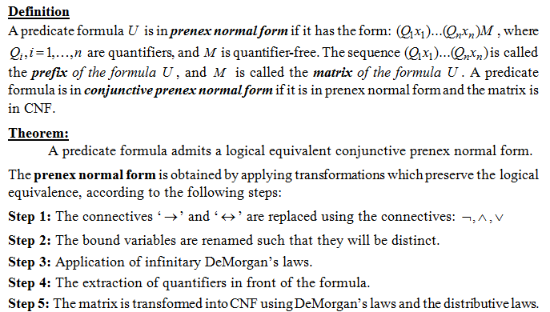
Theory Prenex normal form

Slide 4
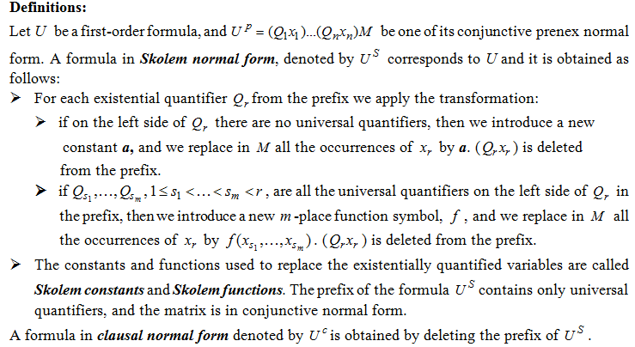
Skolem and clausal normal forms

Slide 5
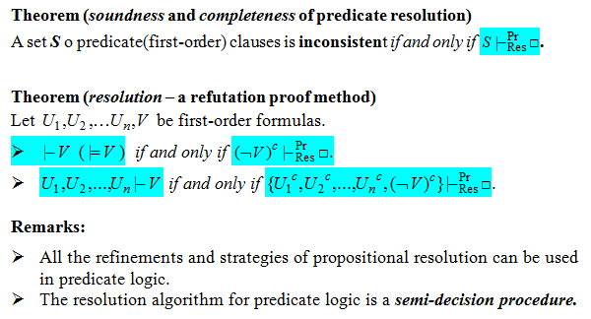
Theoretical results

Slide 6
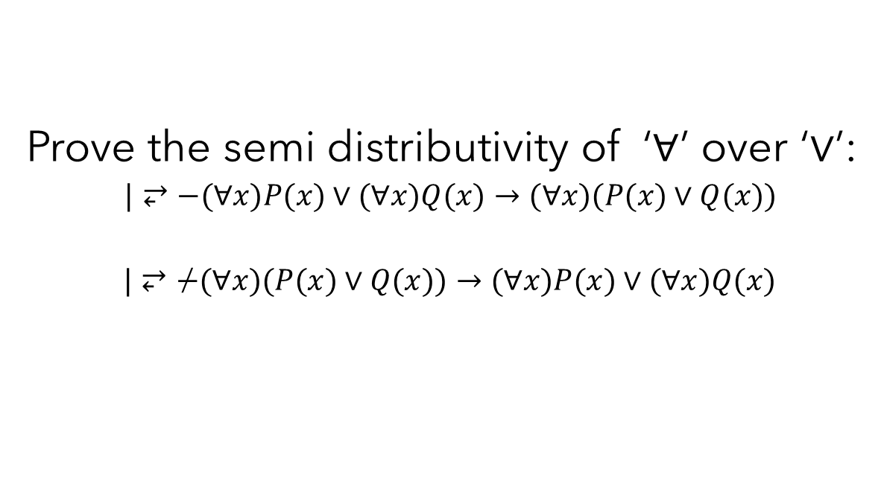
Solution
Prove the semi distributivity of ‘$∀$’ over ‘$∨$’:
$|⥂−(∀x)P(x)∨(∀x)Q(x)→(∀x)(P(x)∨Q(x))$
$$|⥂\overset{̸}{−}(∀x)(P(x)∨Q(x))→(∀x)P(x)∨(∀x)Q(x)$$

Slide 7

We consider the predicate formulas
$U1= (∀x)P(x)∨(∀x)Q(x)→(∀x)(P(x)∨Q(x))$
U2 = $(∀x)(P(x)∨Q(x))→(∀x)P(x)∨(∀x)Q(x)$

Slide 8
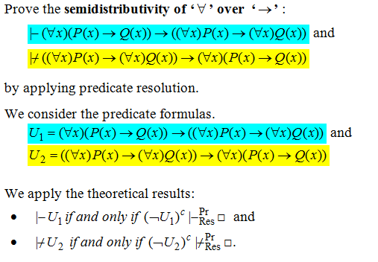

Slide 9
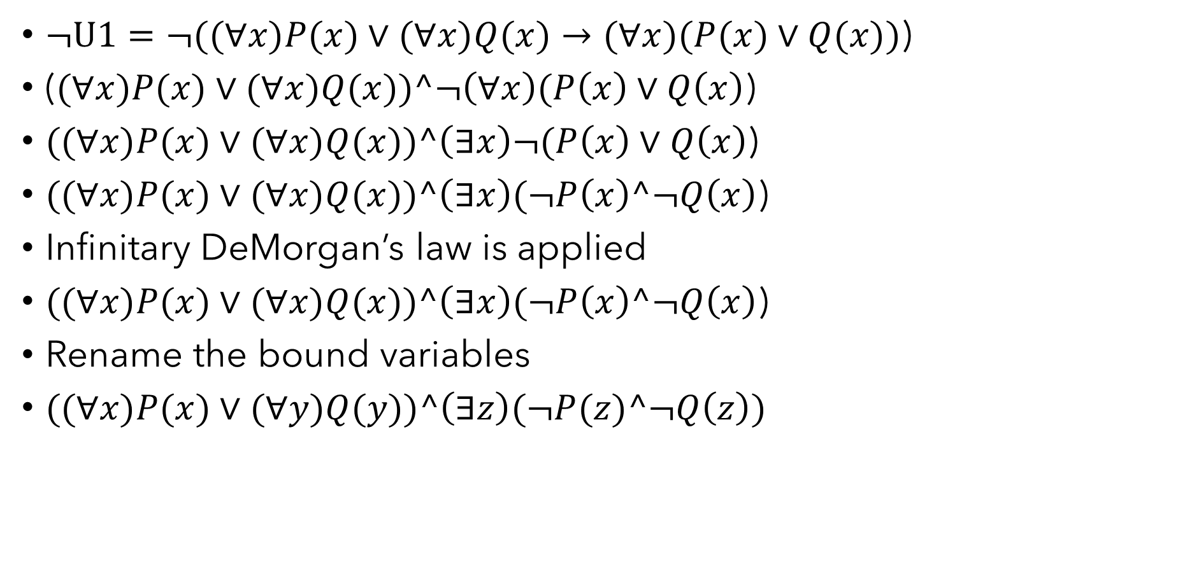
Normal forms
$¬U1=¬((∀x)P(x)∨(∀x)Q(x)→(∀x)(P(x)∨Q(x))$)
($(∀x)P(x)∨(∀x)Q(x))^¬\left(∀x\right)(P\left(x\right)∨Q\left(x\right)$)
$((∀x)P(x)∨(∀x)Q(x))^\left(∃x\right)¬(P\left(x\right)∨Q\left(x\right)$)
$((∀x)P(x)∨(∀x)Q(x))^\left(∃x\right)(¬P\left(x\right)^¬Q\left(x\right)$)
Infinitary DeMorgan’s law is applied
$((∀x)P(x)∨(∀x)Q(x))^\left(∃x\right)(¬P\left(x\right)^¬Q\left(x\right)$)
Rename the bound variables
$((∀x)P(x)∨(∀y)Q(y))^\left(∃z\right)(¬P(z)^¬Q\left(z\right))$

Slide 10
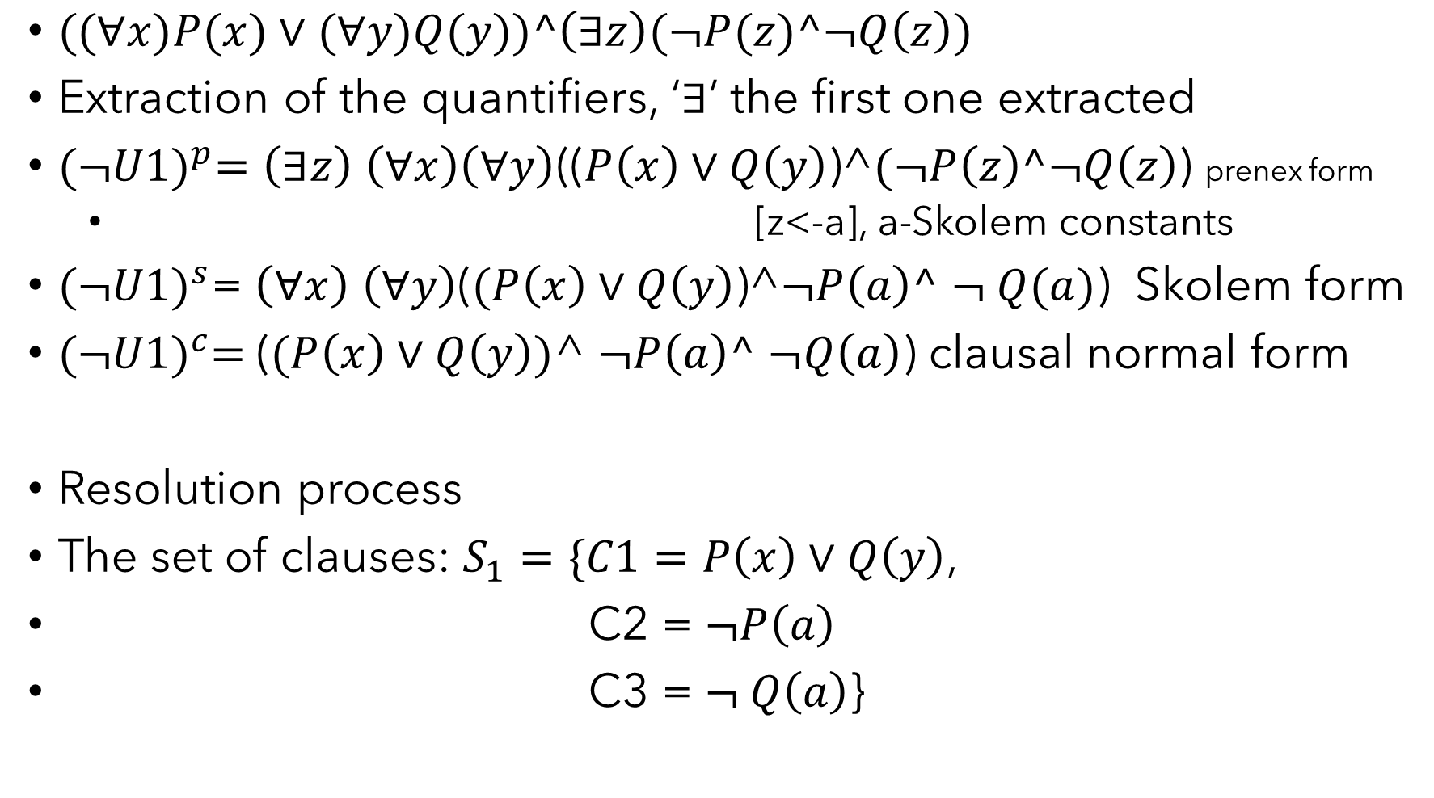
$((∀x)P(x)∨(∀y)Q(y))^\left(∃z\right)(¬P(z)^¬Q\left(z\right))$
Extraction of the quantifiers, ‘$∃$’ the first one extracted
${(¬U1)}^{p}=\left(∃z\right)$ $\left(∀x\right)\left(∀y\right)$(($P\left(x\right)∨Q\left(y\right)$)^$(¬P\left(z\right)^¬Q\left(z\right)$) prenex form
[z<-a], a-Skolem constants
${(¬U1)}^{s}$= $\left(∀x\right)$ $\left(∀y\right)$($(P\left(x\right)∨Q\left(y\right)$)^$¬P\left(a\right)^$ $¬ Q(a)$) Skolem form
${(¬U1)}^{c}=$($(P\left(x\right)∨Q\left(y\right))$^ $¬P\left(a\right)^$ $¬Q\left(a\right)$) clausal normal form
Resolution process
The set of clauses: $S_{1}=\{C1=P\left(x\right)∨Q\left(y\right)$,
C2 = $¬P\left(a\right)$
C3 = $¬ Q\left(a\right)$}

Slide 11

The only resolvent is:
C4=${Res}_{[y<−a]}^{Pr}$(C1,C3) = $P\left(x\right)$
C5=${Res}_{[x<−a]}^{Pr}$(C4,C2) =▢
${(¬U1)}^{c}$ |$−_{Res}^{Pr}$▢, so |-U1

Slide 12
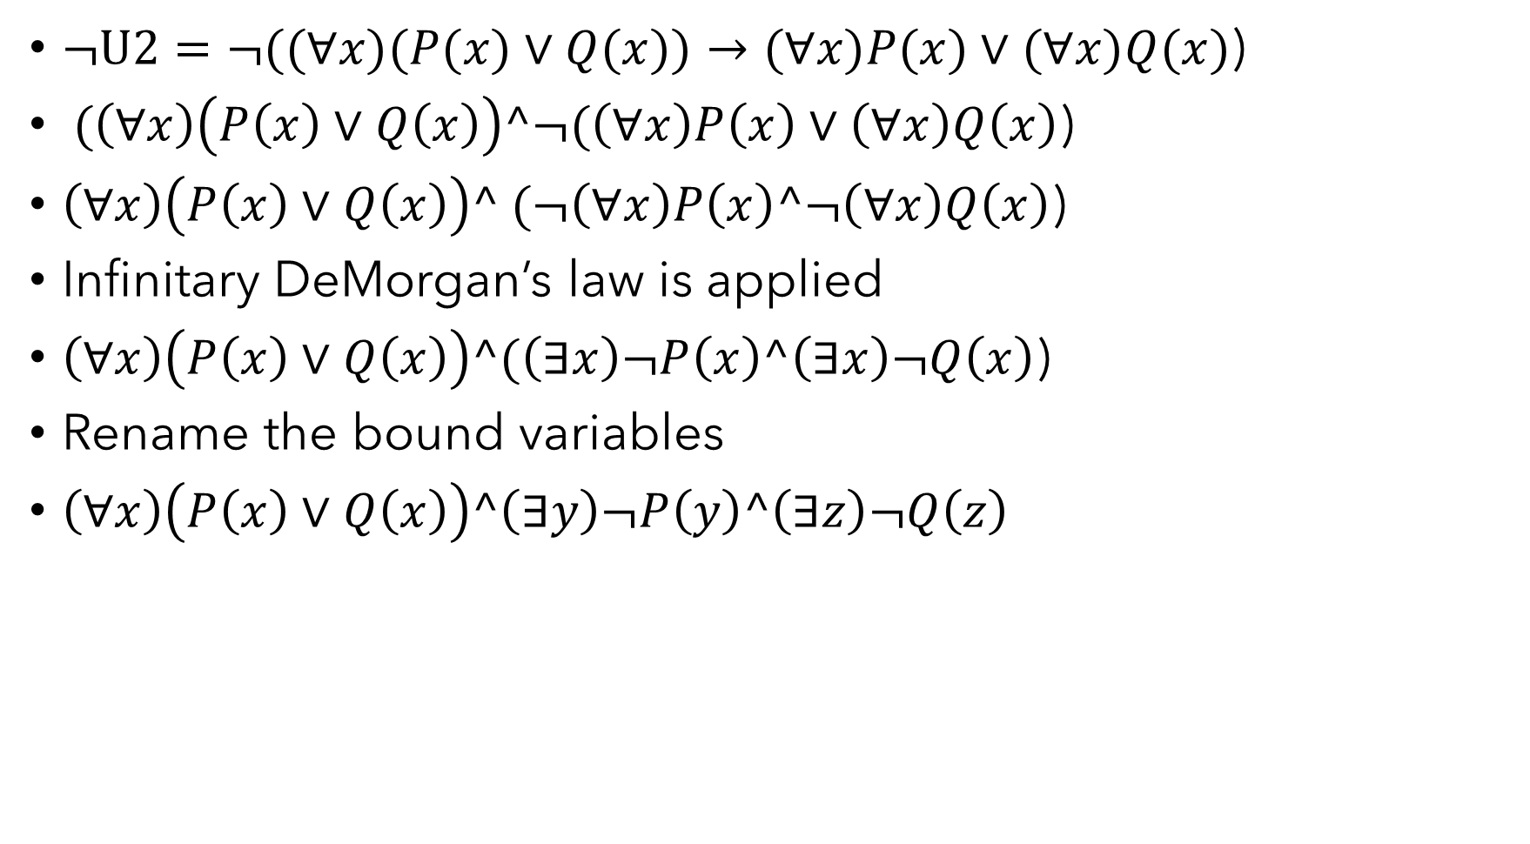
$¬U2=¬((∀x)(P(x)∨Q(x))→(∀x)P(x)∨(∀x)Q(x)$)
$(\left(∀x\right)\left(P\left(x\right)∨Q\left(x\right)\right)^¬(\left(∀x\right)P\left(x\right)∨\left(∀x\right)Q\left(x\right)$)
$\left(∀x\right)\left(P\left(x\right)∨Q\left(x\right)\right)^ (¬\left(∀x\right)P\left(x\right)^¬\left(∀x\right)Q\left(x\right)$)
Infinitary DeMorgan’s law is applied
$\left(∀x\right)\left(P\left(x\right)∨Q\left(x\right)\right)^(\left(∃x\right)¬P\left(x\right)^\left(∃x\right)¬Q\left(x\right)$)
Rename the bound variables
$\left(∀x\right)\left(P\left(x\right)∨Q\left(x\right)\right)^\left(∃y\right)¬P\left(y\right)^\left(∃z\right)¬Q\left(z\right)$

Slide 13
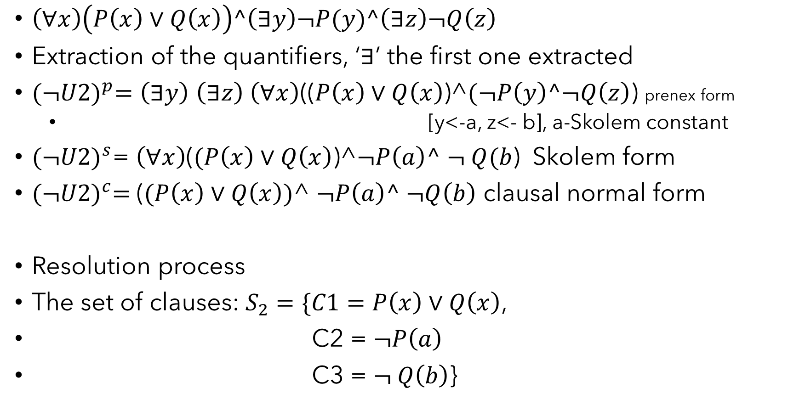
$\left(∀x\right)\left(P\left(x\right)∨Q\left(x\right)\right)^\left(∃y\right)¬P(y)^\left(∃z\right)¬Q\left(z\right)$
Extraction of the quantifiers, ‘$∃$’ the first one extracted
${(¬U2)}^{p}=\left(∃y\right)$ $\left(∃z\right)$ $\left(∀x\right)$(($P\left(x\right)∨Q\left(x\right)$)$\text{^}(¬P\left(y\right)^¬Q\left(z\right)$) prenex form
[y<-a, z<- b], a-Skolem constant
${(¬U2)}^{s}$= $\left(∀x\right)$($(P\left(x\right)∨Q\left(x\right)$)^$¬P\left(a\right)^$ $¬ Q(b$) Skolem form
${(¬U2)}^{c}=$($(P\left(x\right)∨Q\left(x\right))$^ $¬P\left(a\right)^$ $¬Q\left(b\right)$ clausal normal form
Resolution process
The set of clauses: $S_{2}=\{C1=P\left(x\right)∨Q\left(x\right)$,
C2 = $¬P\left(a\right)$
C3 = $¬ Q\left(b\right)$}

Slide 14

The resolvents:
C4=${Res}_{[x<−b]}^{Pr}$(C1,C3) = $P\left(b\right)$
C5=${Res}_{[x<−a]}^{Pr}$(C1,C2) = Q$\left(a\right)$
S1 = {C4, C5}
S2 = ∅
The set of clauses is consistent => U2 is not a logical consequence

